Slide 1

Feature Scaling Techniques
Machine Learning

Slide 2
Taken from Wikipedia,
Feature scaling is a method used to normalize the range of independent variables or features of data. In data processing, it is also known as data normalization and is generally performed during the data pre-processing step.

Slide 3
Since the range of values of raw data varies widely, in some machine learning algorithms, objective functions will not work properly without normalization. For example, many classifiers calculate the distance between two points by the Euclidean distance. If one of the features has a broad range of values, the distance will be governed by this particular feature. Therefore, the range of all features should be normalized so that each feature contributes approximately proportionately to the final distance.
Another reason why feature scaling is applied is that gradient descent converges much faster with feature scaling than without it.

Slide 4
So the question arises… which algorithms need feature scaling?
Linear based models, ones which calculate distances as a part of their algorithm need data to be scaled.
For example, Linear and Logistic Regression, SVMs, PCA, LDA, KNN, K-Means clustering

Slide 5
And which algorithms do NOT need feature scaling?
Tree based models, which essentially ask “inequality” based questions to make splits at each node, do NOT need data to be scaled.
For example, Decision Trees, Random Forests, Gradient Boosting Trees etc.

Slide 6
Different Feature Scaling Techniques:
StandardScaler
MinMaxScaler
RobustScaler
MaxAbsScaler
PowerTransformer
QuantileTransformer
Normalizer

Slide 7
StandardScaler
Useful when the feature follows a normal-like distribution, not so much otherwise.
Scales the features to have zero mean and standard deviation of one, to give it a feel and properties of “standard” normal distribution
It does NOT perform well on features that have outliers.
Does not change shape of distribution of the feature.

Slide 8
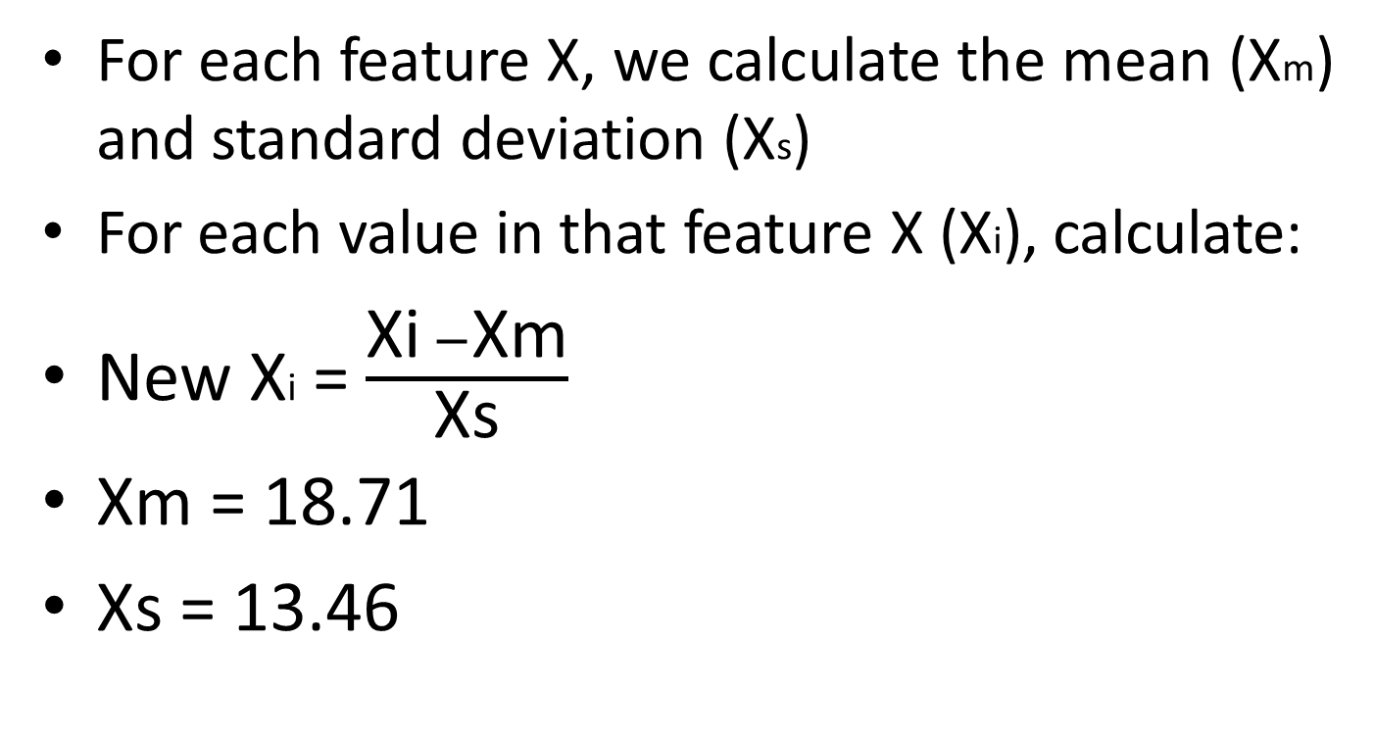
StandardScaler
For each feature X, we calculate the mean (Xm) and standard deviation (Xs)
For each value in that feature X (Xi), calculate:
New Xi = $\frac{\text{Xi} −\text{X}\text{m}}{\text{Xs}}$
Xm = 18.71
Xs = 13.46
original | scaled
5 | -1.01857
10 | -0.6471
12 | -0.49851
14 | -0.34993
18 | -0.05275
23 | 0.318722
49 | 2.250371

Slide 9
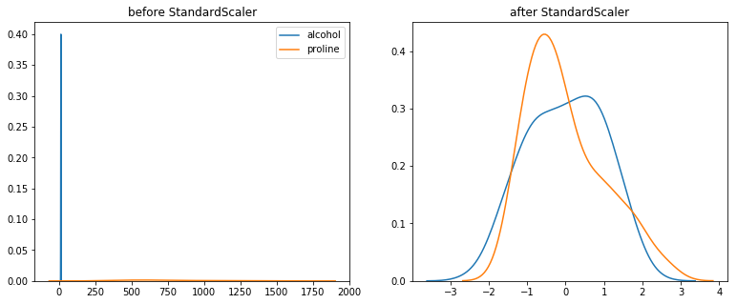
StandardScaler

Slide 10
MinMaxScaler
Scales the range of features between 0 and 1.
Could work well on data that is NOT normally distributed (bell shaped)
It does NOT perform well on features that have outliers.
Does not change shape of distribution of the feature.

Slide 11
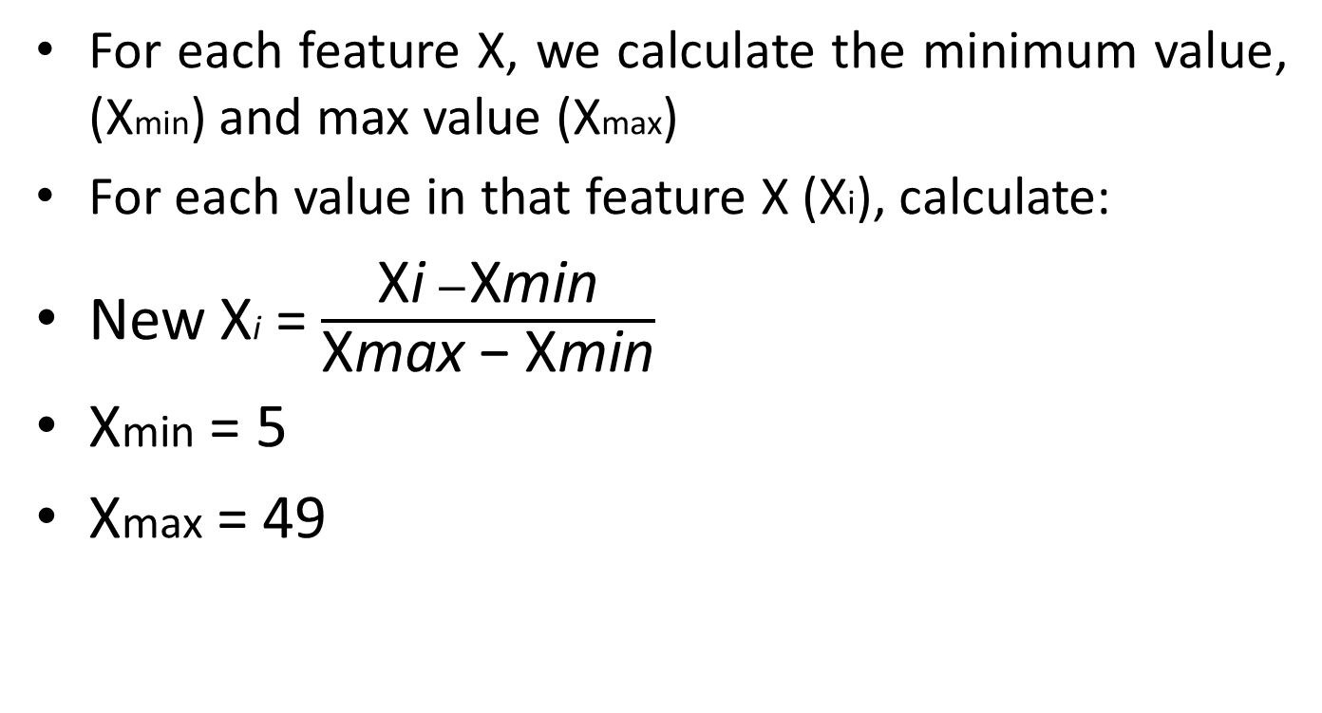
MinMaxScaler
For each feature X, we calculate the minimum value, (Xmin) and max value (Xmax)
For each value in that feature X (Xi), calculate:
New Xi = $\frac{\text{X}\text{i} −\text{X}\text{min}}{\text{X}\text{max}\text{ − }\text{X}\text{min}}$
Xmin = 5
Xmax = 49
original | scaled
5 | 0
10 | 0.113636
12 | 0.159091
14 | 0.204545
18 | 0.295455
23 | 0.409091
49 | 1

Slide 12
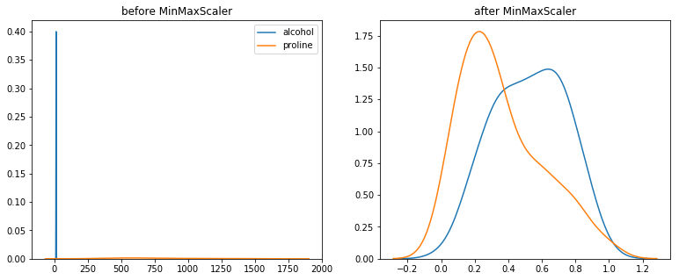
MinMaxScaler

Slide 13
RobustScaler
Useful when feature has marginal outliers.
Subtracts the median, and not mean.
Does not take into account the min and max values, instead uses Inter Quantile Range (IQR).
Hence is generally “robust” to outliers.
But it will not completely remove outliers.
Could be used when neither StandardScaler nor MinMaxScaler is appropriate, due to presence of outliers.
Does little to change shape of distribution of a feature.

Slide 14
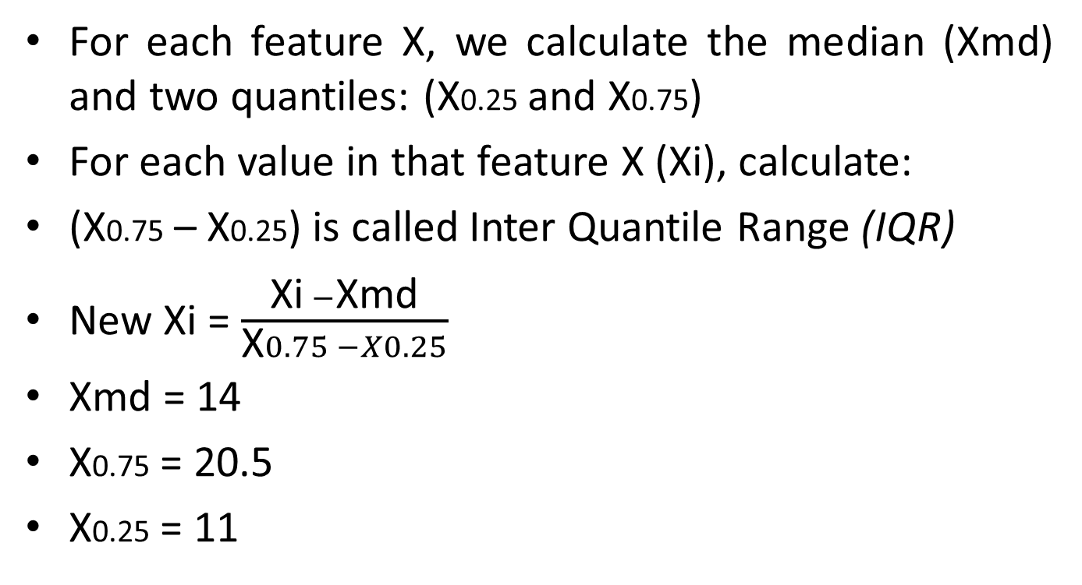
RobustScaler
For each feature X, we calculate the median (Xmd) and two quantiles: (X0.25 and X0.75)
For each value in that feature X (Xi), calculate:
(X0.75 – X0.25) is called Inter Quantile Range (IQR)
New Xi = $\frac{\text{Xi} −\text{Xmd}}{\text{X}0.75 −X0.25}$
Xmd = 14
X0.75 = 20.5
X0.25 = 11
original | scaled
5 | -0.94737
10 | -0.42105
12 | -0.21053
14 | 0
18 | 0.421053
23 | 0.947368
49 | 3.684211

Slide 15
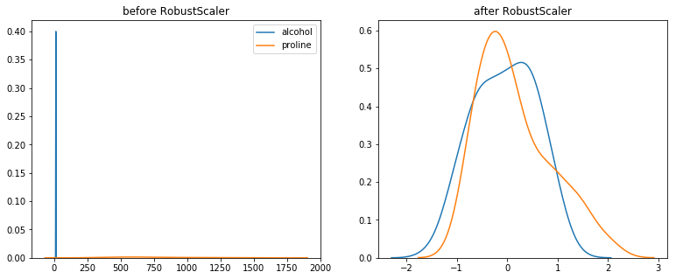
RobustScaler

Slide 16
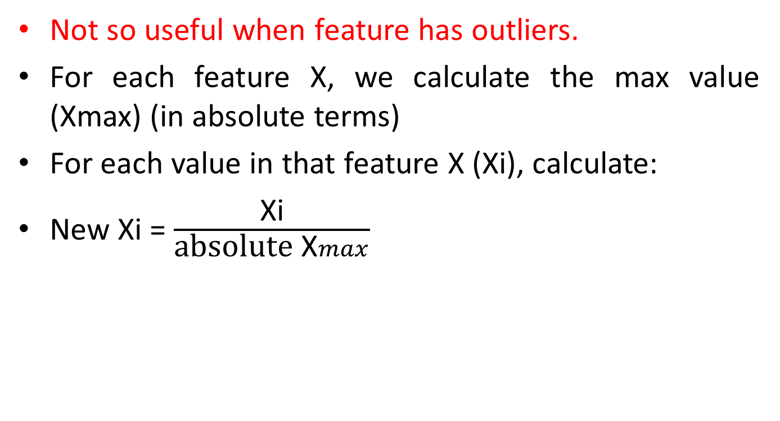
MaxAbsScaler
Not so useful when feature has outliers.
For each feature X, we calculate the max value (Xmax) (in absolute terms)
For each value in that feature X (Xi), calculate:
New Xi = $\frac{\text{Xi}}{\text{absolute} \text{X}max}$
original | scaled
-5 | -0.10204
10 | 0.204082
12 | 0.244898
-14 | -0.28571
18 | 0.367347
23 | 0.469388
-49 | -1

Slide 17
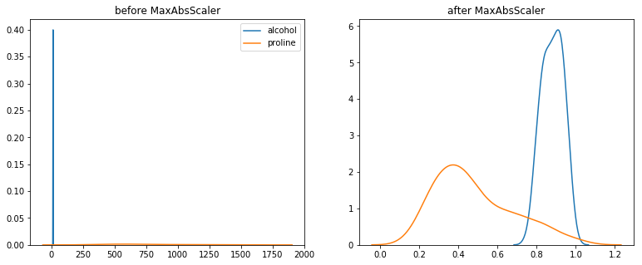
MaxAbsScaler

Slide 18
PowerTransformer
When desired output is more “Gaussian” like
Currently has ‘Box-Cox’ and ‘Yeo-Johnson’ transforms
Box-Cox requires the input data to be strictly positive (not even zero is acceptable).
For features which have zeroes or negative values, Yeo-Johnson comes to the rescue.

Slide 19
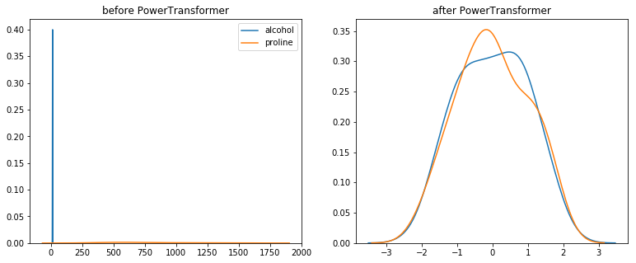
PowerTransformer

Slide 20
QuantileTransformer
Useful when feature has outliers.
This method transforms the features to follow a uniform or a normal distribution. Therefore, for a given feature, this transformation tends to spread out the most frequent values. It also reduces the impact of (marginal) outliers: this is therefore a robust preprocessing scheme.
Makes data more Gaussian-like.

Slide 21
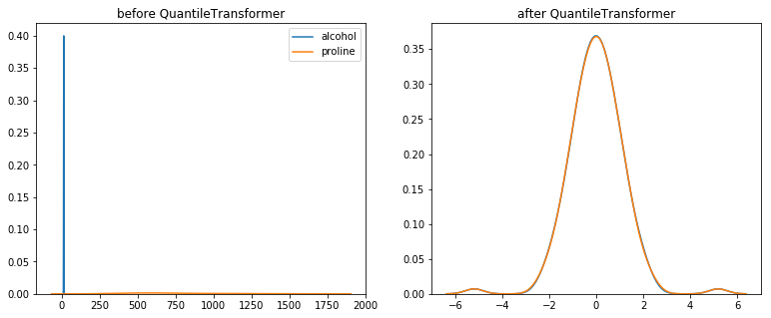
QuantileTransformer

Slide 22
Normalizer
Computes row-wise calculations, instead of the column-wise we’ve been seeing all along
Useful for clustering and text-classification tasks
Can use l1 (Manhattan), l2 (Euclidean) distances as “norm” parameter.
Also an option for norm=‘max’, to scale values by simply dividing element in each row by the max value in that entire row.

Slide 23
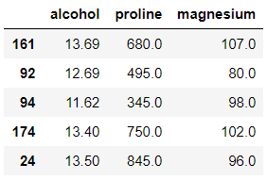
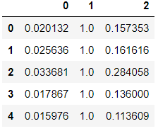
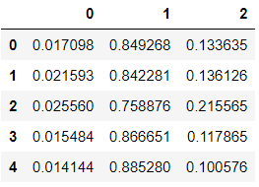
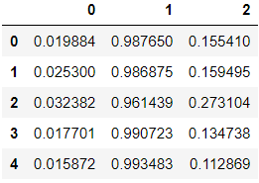
Normalizer
max | l1 | l2
680 | 800.69 | 688.5
495 | 587.69 | 501.58
Dividing factor for first two rows
norm=‘max’
norm=‘l1’
norm=‘l2’

Slide 24
Exponential and log transformer
Just like any other feature scaling technique really – applying a mathematical formula to the columns and scaling them accordingly.
Utilizes sklearn’s FunctionTransformer class to do the mathematical calculations
Here, we make use of the simple mathematical transformations like taking log, squaring, taking square roots, cube roots etc.
Could be useful on a case by case basis, we just need to check different things.

Slide 25
Exponential and log transformer
original | scaled
5 | 2.236
10 | 3.162
12 | 3.464
14 | 3.741
18 | 4.242
23 | 4.795
49 | 7
Square root transformer

Slide 26
References
https://scikit-learn.org/stable/auto_examples/preprocessing/plot_all_scaling.html
https://sebastianraschka.com/Articles/2014_about_feature_scaling.html
https://www.quora.com/Which-machine-algorithms-require-data-scaling-normalization
https://machinelearningmastery.com/standardscaler-and-minmaxscaler-transforms-in-python/
https://towardsai.net/p/data-science/how-when-and-why-should-you-normalize-standardize-rescale-your-data-3f083def38ff
https://machinelearningmastery.com/standardscaler-and-minmaxscaler-transforms-in-python/

